Slide 1
UPI FRAUD DETECTION
Team No: 01
Student name: M. Sai Teja Guide Name: Ram Babu
Ht.No :21EG07B58 Designation :
Student name: A. Vishnu Vardhan Reddy
Ht.No :21EG107B55
Student name: J. Aryan Shiv Yadav
Ht.No :21EG107B12

Slide 2
ABSTRACT
This paper presents a machine learning-based extortion location framework for UPI exchanges utilizing the XGBoost calculation. The framework successfully distinguishes false designs by utilizing Destroyed to adjust the information and PCA to rearrange it. The demonstration accomplishes a tall exactness rate of 98.2%, guaranteeing solid discovery of suspicious exchanges. The framework works in real-time, ceaselessly checking UPI exchanges and sending moment cautions to avoid potential extortion. Its combination of progressed procedures upgrades security and diminishes monetary dangers, making it a vigorous arrangement for making strides in the security of computerized installments on the UPI stage.

Slide 3
INTRODUCTION
UPI has transformed financial transactions by offering a seamless and instant payment system.
However, the rise in UPI usage has also increased the risk of fraud, creating challenges for financial security.
This paper proposes a machine learning-based fraud detection system tailored for UPI transactions.
The system uses advanced algorithms like XGBoost and data balancing techniques like SMOTE and Principal Component Analysis (PCA).
Its goal is to enhance fraud detection accuracy, enabling real-time monitoring and improving protection against evolving fraudulent activities.

Slide 4
EXISTING SYSTEM
Existing UPI fraud detection systems rely on conventional rule-based methods.
These systems use predefined rules like transaction limits and frequency checks to flag suspicious activities.
While effective for known fraud patterns, they produce many false positives.
They struggle to adapt to new, sophisticated fraud techniques.
Lack of real-time processing leads to delayed responses, leaving users vulnerable to fraudulent transactions.

Slide 5
Limitations Of Existing System
Dependence on static, rule-based methods leads to missed detection of evolving fraud patterns.
Scalability issues prevent the effective handling of large transaction volumes in real-time.
Limited adaptability makes current systems ineffective against new and changing fraud techniques.
Insufficient feature extraction capabilities reduce accuracy in detecting complex fraudulent activities.
Challenges with imbalanced datasets result in models biased toward non-fraudulent transactions, lowering fraud detection effectiveness.

Slide 6
LITERATURE REVIEW
S.NO | TITLE OF THE PAPER | YEAR OF PUBLICATION | ALGORITHMS | DRAWBACKS
1 | Data Engineering for Fraud Detection | 2023 | SMOTE, Decision Tree, Random Forest, Neural Network, KNN | Efficiency decreases when trained with imbalanced datasets
2 | Principal Component Analysis | 2022 | PCA (Principal Component Analysis) | May lack clear interpretability of results
3 | Fraud Detection System: A Survey | 2021 | ROS (Random Over Sampling), RUS (Random Under Sampling) | Loss of valuable data due to under-sampling

Slide 7
METHODOLOGY
Data Collection
Data Preprocessing
Feature Extraction
Model ->(Selection, Training, Evaluation)
Decision Making
Real-Time Monitoring
Report Generation

Slide 8
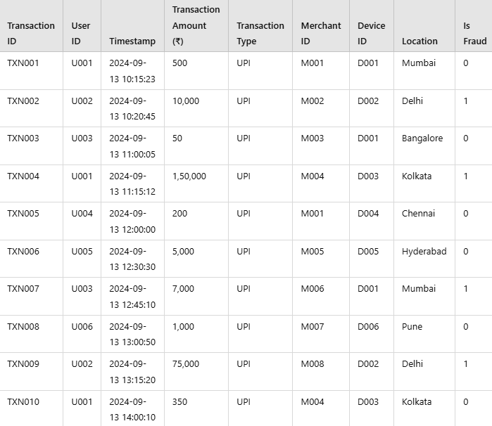
Sample Dataset

Slide 9
METHODOLOGY
The fraud detection strategy starts with collecting transaction details such as user ID, amount, timestamp, device, location, and fraud labels.
Data preprocessing follows, cleaning and balancing the dataset using techniques like SMOTE to address class imbalances.
Feature selection and scaling prepare the data for model training.
An algorithm, such as XGBoost, is trained on the preprocessed data and evaluated using metrics like accuracy, precision, recall, and F1 score.
The model is deployed for real-time monitoring, continuously improving through feedback and performance analysis.
DATASET
The dataset comprises of UPI exchange subtle elements, counting timestamps, sums, and client data, pointed at recognizing extortion. It is imbalanced, with fewer false exchanges, tended to by Destroyed to create manufactured extortion tests. PCA is utilized for dimensionality decrease, rearranging the dataset. The XGBoost calculation is connected to the handled information for real-time extortion location. This demonstrates accomplishes tall exactness (98.2%) in distinguishing false exchanges.

Slide 10
PROPOSED SYSTEM
Various modern techniques, like artificial neural networks, are explored for fraud detection.
Machine learning algorithms such as Auto Encoder, Local Outlier Factor, and K-means Clustering are compared.
The project applies algorithms and neural networks to find optimal solutions for identifying fraudulent transactions.
The primary goal is to detect fraud and develop a method for generating test data.
Implementing an efficient fraud detection system is essential for UPI providers and their clients to minimize losses.

Slide 11
Advantages Of Proposed System
Enhanced accuracy
Adaptability to changing patterns
Continuous improvement
Comprehensive fraud detection
Scalability and efficiency
Real-time detection

Slide 12
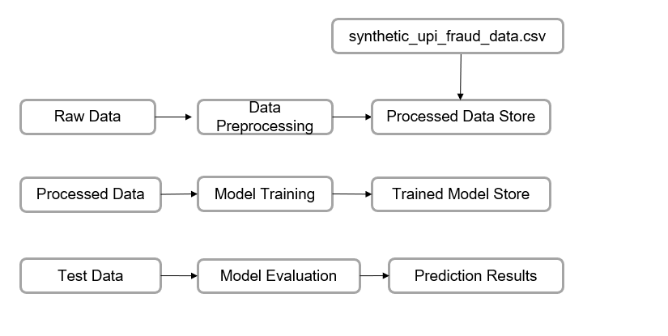
Data Flow Diagram
Level - 01

Slide 13
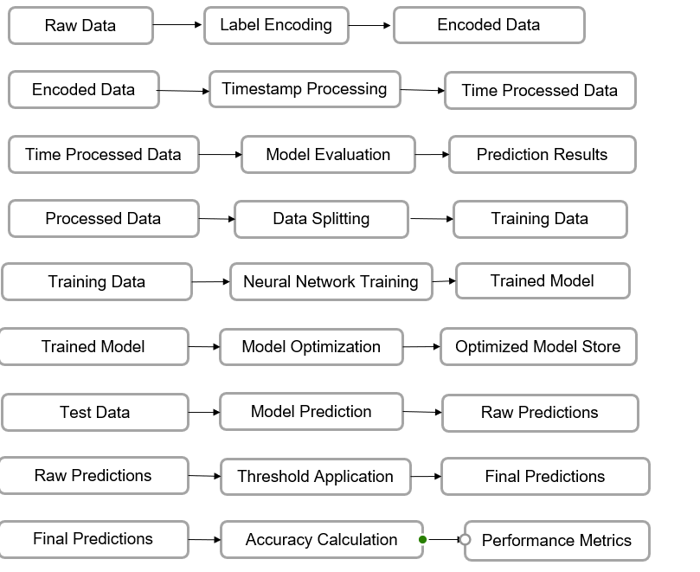
Data Flow Diagram
LEVEL - 02

Slide 14
Synopsis
UPI fraud detection focuses on identifying and preventing fraudulent transactions in real-time to protect users from unauthorized activities.
Machine learning models analyze transaction patterns and user behavior to detect anomalies.
Behavioral analysis monitors transaction frequency, location, and timing to identify deviations from typical user behavior.
Real-time monitoring enables quick detection and response to suspicious activities as they occur.
Risk scoring assigns a risk score to transactions based on factors like amount, device details, and past behavior.
Multi-factor authentication adds extra verification steps for high-risk transactions, such as OTPs or biometrics.
Phishing detection prevents scams by identifying malicious URLs and unusual patterns.
User alerts notify users of suspicious activities, enabling them to respond quickly.

Slide 15
CONCLUSION
UPI fraud has become a serious concern to the world. Fraud brings huge financial losses to the world. This urged UPI companies to invest money to create and develop techniques to reveal and reduce fraud. The prime goal of this study is to define algorithms that confer the appropriate and can be adapted by UPI companies for identifying fraudulent transactions more accurately, in less time and cost. Different machine learning algorithms are compared.

Slide 16
References Format-IEEE
J F.Axlin Jenes, N.Mahendran, “UPI FRAUD DETECTION USING MACHINE LEARNING,” Journal Name, vol. Volume, no. Number, pp. Page range, March 2024, DOI.
Hua, C., Lee, V., Smith, K., & Gayle, R. (2010). A comprehensive survey of data mining-based fraud detection research. DOI: 10.48550/ARXIV.1009.6119.
Abdallah, A., Maruf, M. A., & Zainal, A. (2016). Fraud detection system: A survey. Journal of Network and Computer Applications, 68, 90-113.

